Slide 1
AI-101 MINI PROJECT · TEAM 75
THE TEAM
Prediction of Price of EV
Mallipudi Praveenya Sai
Documentation Lead · 2026EEB1374
Vushakoyyala Sriram
Video Lead · 2026MCB1581
Estimating an electric car’s price from its battery, range and performance specifications
Md Aayan Ali
PPT Lead · 2026EEB1377
Ashok Thalor
Execution Lead · 2026AIB1022
Repository github.com/praveenya1374/ai-project-team-75

Slide 2
The problem and the data
What we predict
10,000
9
Our dataset lists 10,000 EVs with their specifications and price. We train a model to estimate an EV’s price in INR Lakh from those specifications.
rows
columns
8
0
Why it matters
input features
missing values
Price depends on battery, range, power and more at the same time. The model shows how much each specification adds to the price.
Dataset india_ev_car_features_price.csv (AI-generated dataset)
Inputs Battery capacity, range, motor power, top speed, charging time, seats, fast-charging support, boot space
Target Price (INR Lakh)

Slide 3
Our approach
1
2
3
4
5
Load data
→
Clean
→
Features
→
Train
→
Evaluate
Read the EV CSV with pandas; inspect shape and types
Check for missing values; median fill if any (none found)
8 specifications as X, price as y
80/20 split. Multiple Linear Regression on all 8 features
Predict on 2,000 test cars; MAE, MSE, RMSE, R²
Libraries used
pandas
Data handling
NumPy
Numerical work
Matplotlib
Charts
scikit-learn
Model and metrics

Slide 4
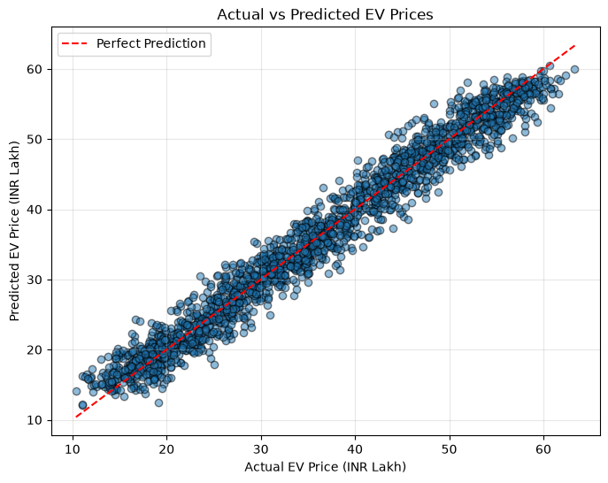
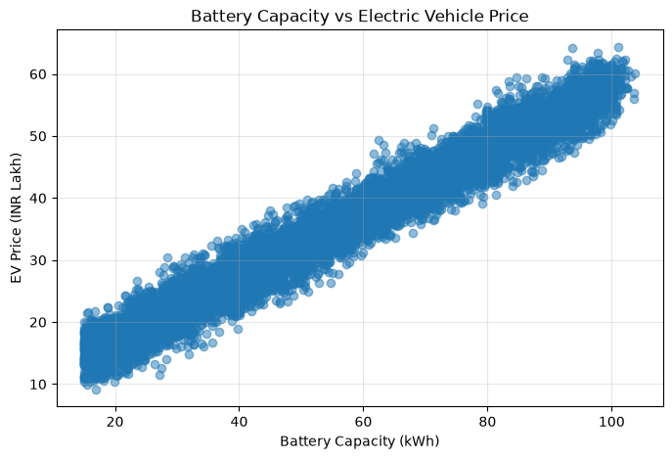
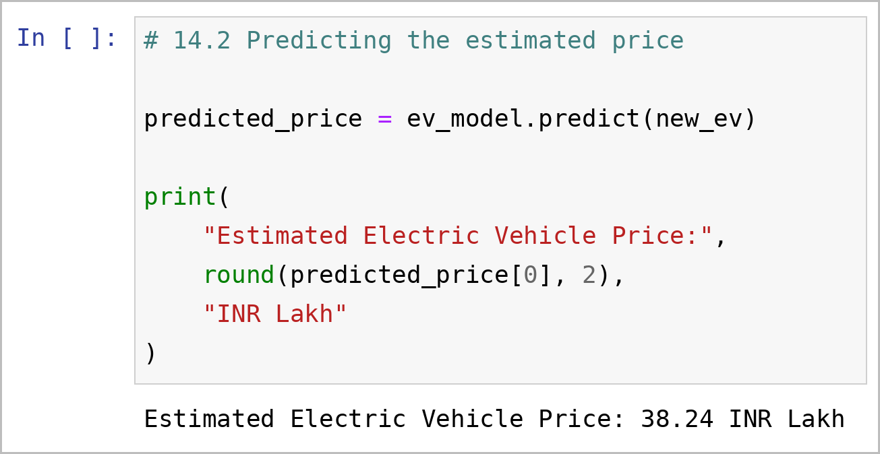
Results
0.9665
R² score
1.908
MAE (Lakh)
2.417
RMSE (Lakh)
5.842
MSE
Actual vs predicted (test set)
Battery capacity vs price
Feature | Coef. | Feature | Coef.
Battery (kWh) | 0.4136 | Range (km) | 0.0073
Motor power (kW) | 0.0228 | Top speed (km/h) | 0.0110
Charging time (h) | 0.0094 | Seats | 0.2057
Fast charging | 1.2949 | Boot space (L) | 0.0042
Intercept | 1.6086
Demo: predicting the price of a new EV (cell 14.2)
Inputs: 60 kWh, 400 km, 150 kW, 150 km/h, 4 h charge, 5 seats, fast charging, 350 L boot

Slide 5
Learnings
What worked
What didn’t
Who did what
Plain linear regression reached R² 0.9665
Battery capacity tracks price almost linearly
Each kWh of battery adds about 0.41 Lakh; fast charging adds about 1.29 Lakh
Clean data: no missing values to fix
One 80/20 split, no cross-validation
Only a linear model; no other models compared
Dataset is AI-generated: the high R² may partly reflect its near-linear pattern, so real prices may differ
Next: try Random Forest and cross-validate
Praveenya: dataset loading, exploration, cleaning
Sriram: features, target, EDA charts
Aayan: split, training, evaluation
Ashok: final plots, new-EV prediction, integration, docs, repo
AI-use disclosure Our dataset is AI-generated. AI was used only for README formatting and project code structuring. No AI was used to generate the results.

